Slide 1
BLOCKCHAIN AND Cryptocurrency
SUSHMITA RAVINDRANATH PUNNESHETTY
20th November 2018

Slide 2
contents
History of blockchain and cryptocurrency
What is Blockchain?
What is Cryptocurrency?
what is Mining?

Slide 3
History
1991 – FIRST OCCURANCE OF BLOCKCHAIN BY STUART HABER AND W. SCOTT STORNETTA.
1992 -- INCORPORATED MERKLE TREES.
2002 -- DECENTRALIZED TRUST WITHIN THE NETWORK.
2005 -- BITGOLD ( PROOF OF WORK AND TIMESTAMPING) , DOUBLE SPENDING PROBLEM.
2008 -- SATOSHI NAKAMOTO PUBLISHED A PAPER ON BITCOIN (FIRST WORKING BLOCKCHAIN)
2009 – BITCOIN WAS LAUNCHED.
2014 – BLOCKCHAIN 2.0 ( DECENTRALIZED APPS AND SMART CONTRACTS)
2015 -- ETHEREUM

Slide 4
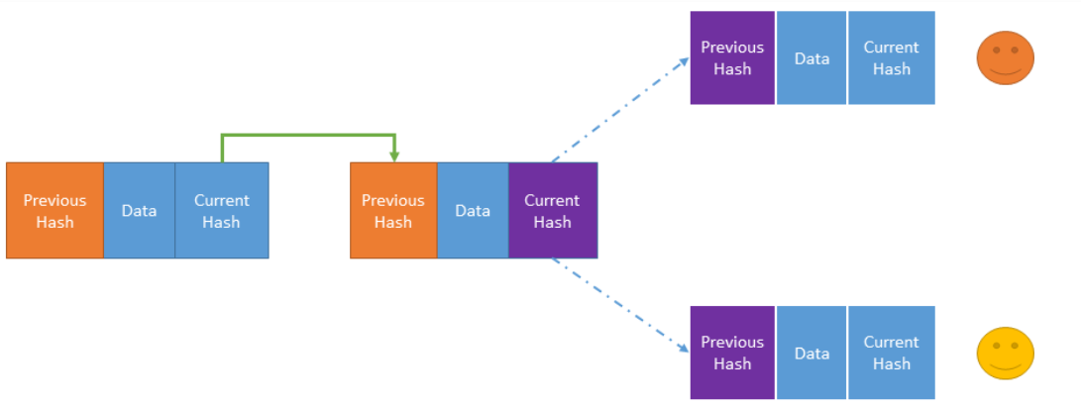
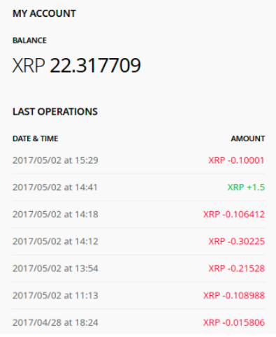
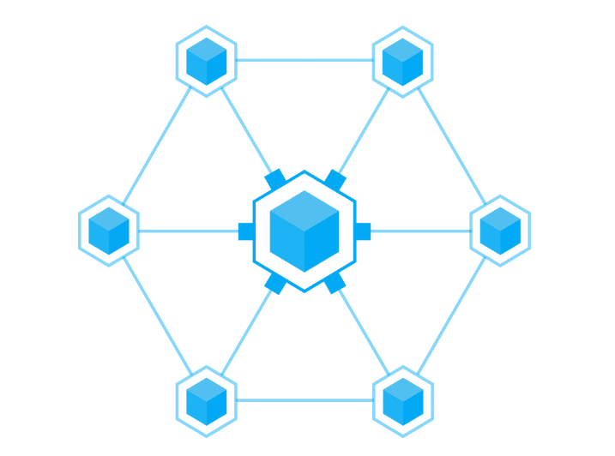
Blockchain
Chronological order
No intermediary
Distributed ledger
Irreversibility
Immutable
Real-time data
Distributed ledger
Nodes
BLOCKCHAIN NETWORK

Slide 5
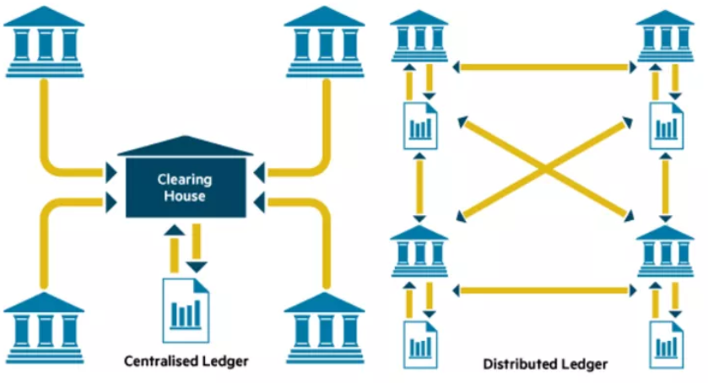

Slide 6
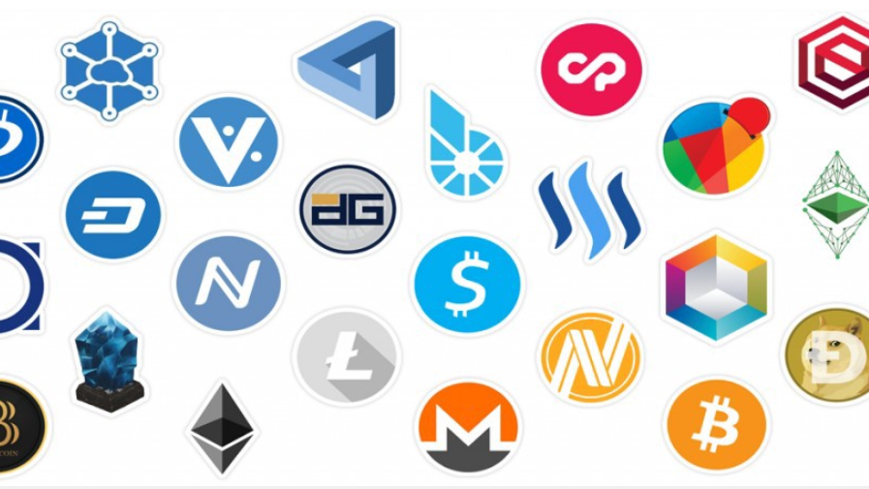
Cryptocurrency
DIGITAL MEDIUM OF EXCHANGE
01
NO CENTRALIZED AUTHORITY
02
PROTOCOL BUILT ON BLOCKCHAIN
03

Slide 7
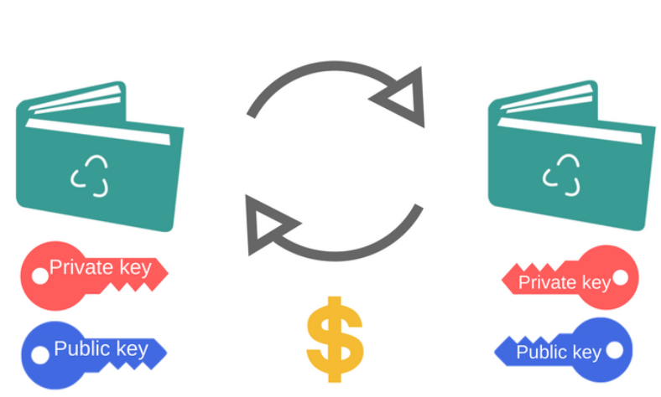
MINING
DIGITAL WALLET ON THE NETWORK
KEEP TRACK OF THE LEDGERS
VALIDATE TRANSACTIONS
MINERS:
USE COMPUTATIONAL ALGORITHM : CRYPTOGRAPHIC HASH FUNCTION: SHA256
NO FRAUDULENT TRANSACTIONS

Slide 8
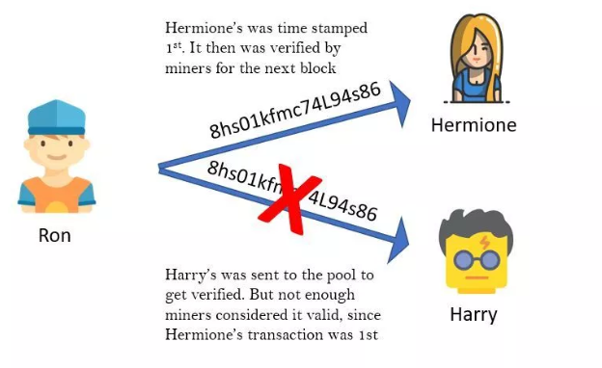
Double spending problem

Slide 9
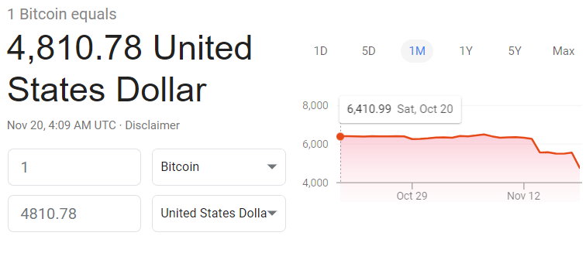
What happens when a miner successfully adds a block to the blockchain ?

Slide 10
THANK YOU

